Slide 1
Nawal el-Saadawi, feminist of the Arabs
By Per Gahrton, Phd Sociology, former MP and MEP, Sweden, author of Egypt -an Arab democracy (1987), Egypt triangle drama (1912) – both in Swedish

Slide 2
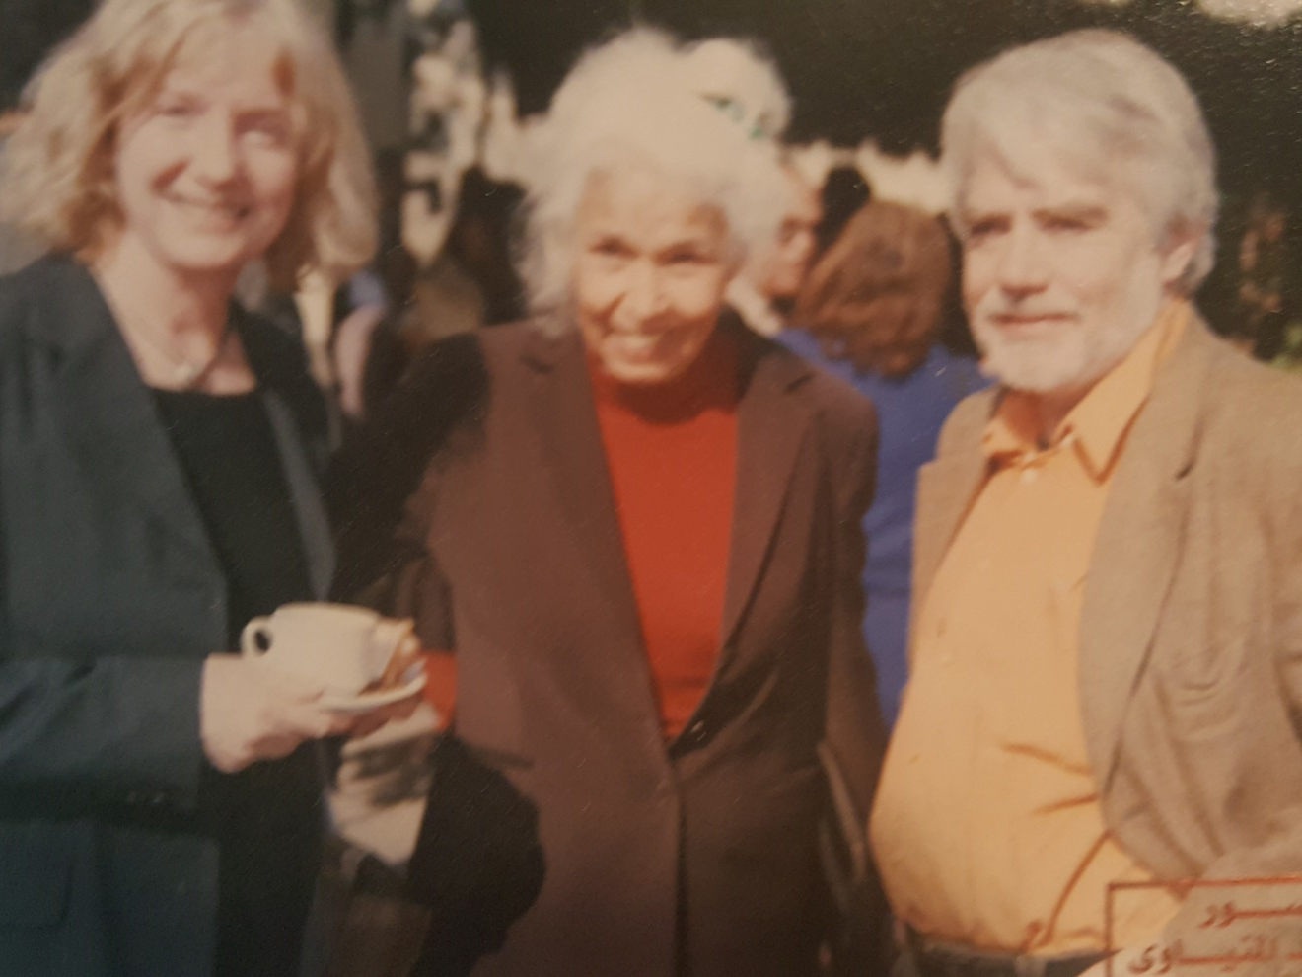
Per Gahrton with wife Prof Drude Dahlerup and Nawal el Saadawi

Slide 3
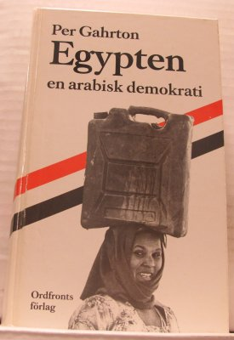
Egypt - an Arab democracy
(There should have been a question mark!)

Slide 4
I first met Nawal in 1975, not in person, but through one of her first books – al-Mara’ w-al Gins (Women and Sex) - which I came across in Beirut.
My translations of words on the first few pages say a lot about what was new and shocking to me and at the same time represent the core of the book: Khitan = circumcision, ‘ifa = chastity, ithm = sin, nagasa = uncleanliness.
In her introduction to the first edition, Nawal writes about victims of khitan:
“Some died a real physical death during abortion or circumcision or bearing under bad circumstances or being killed for not showing blood to prove virginity, some died psychologically or socially”.
She lost her job at the ministry of Health.

Slide 5
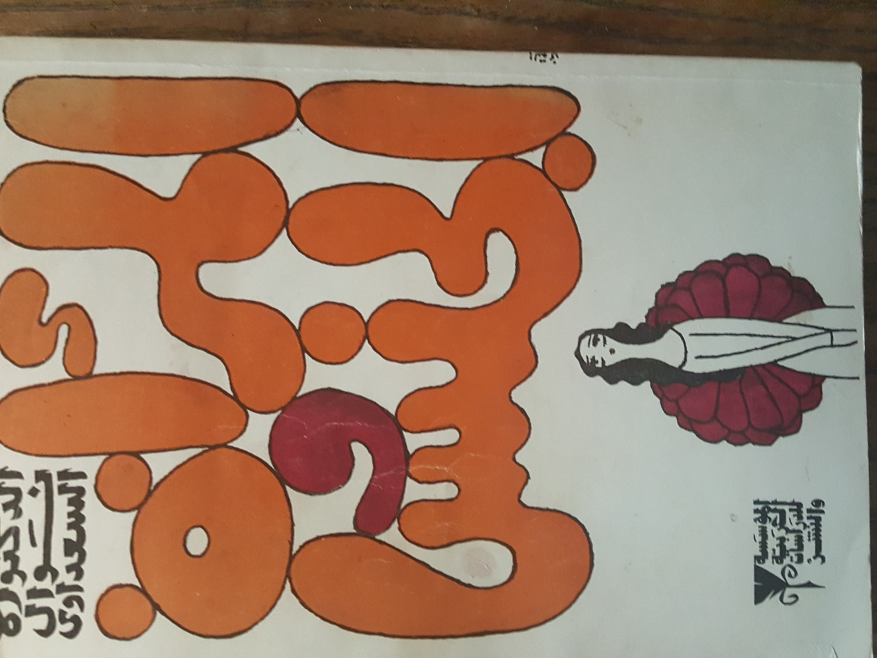

Slide 6
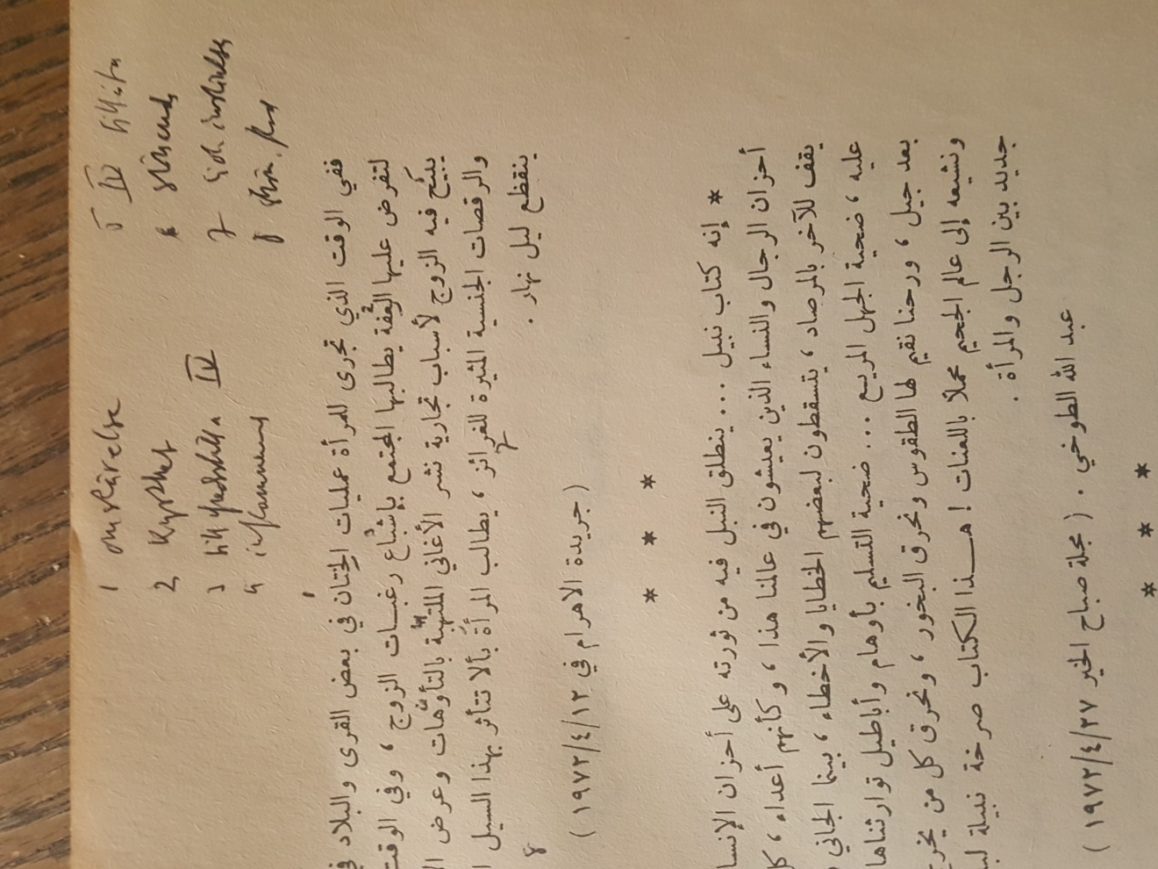
My translations of chocking words in al mara’ w’al gins

Slide 7
2. In Sadats prison 1981
In September 1981 Nawal was put in prison by president Anwar al-Sadat. She took notes on toilet paper, which resulted in Memoirs from a women’s prison. She spent three months in a cell for “political women”, both left-wingers and Islamists.
Nawal quotes a prostitute, Dhuba: “Behind every woman who has entered prison there’s a real son of a bitch. Father, husband, brother, uncle, cousin. Any man.”
The news that Sadat was killed at the 6th October parade was greeted with jubilations! The fundamentalists whirled around without niqab, and the left wingers kneeled and thanked God.
On November 25 she was brought to the new president, Husni Mubarak , he clasped her hand and uttered “frank, sincere words”. After some days all of them were released. But Mubarak’s nice words about freedom etc were never followed by deeds.

Slide 8
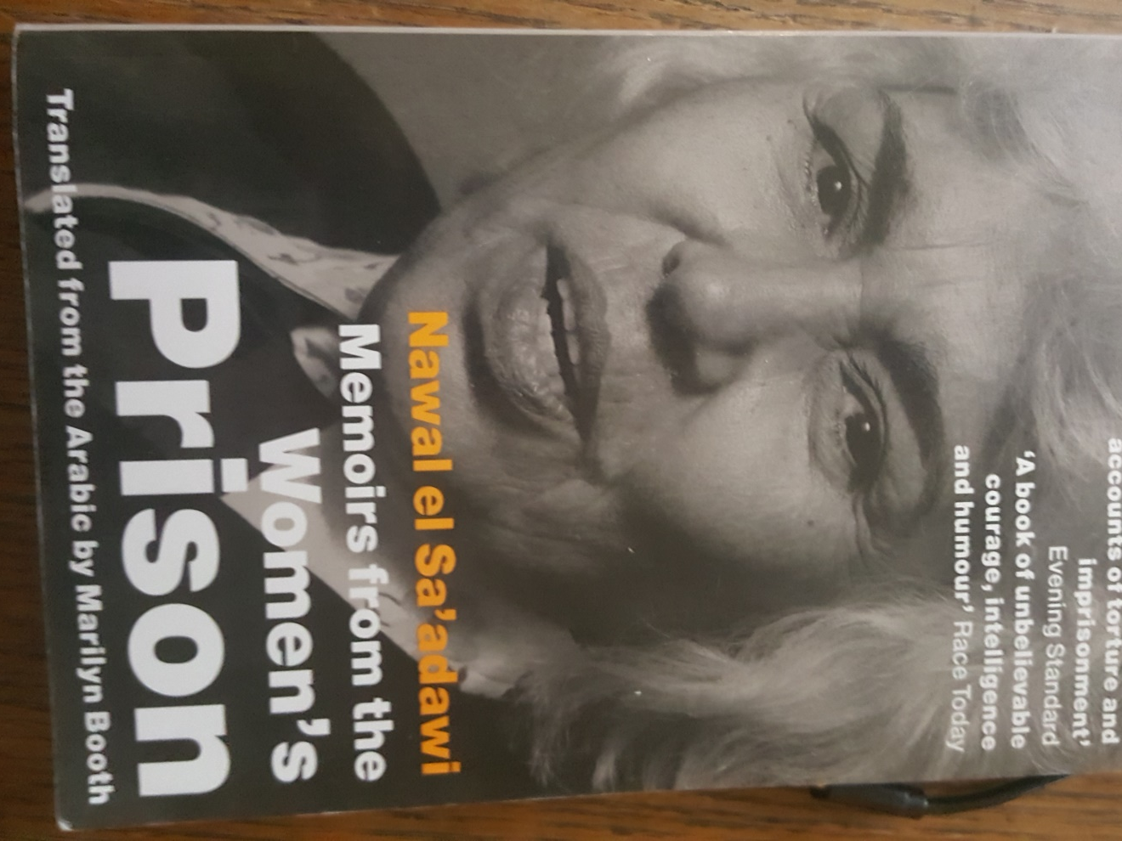

Slide 9
3. Nawal’s ideology
Nawal’s political ideology is summarized in her introduction to a conference in January 2002, which I attended:
“Systems change from kingdoms to republics, or to people’s democracies, or to neoliberal democracies but the essence remains the same: power and riches for the few, and poverty, deprivation and little freedom for the many”.
In May 2005 Nawal launched herself as candidate for the presidency, which resulted in wide spread debate. But “an important member of the ruling party said I was a mad”.

Slide 10
4. Nawal and Egyptian intellectuals
In May 2009, in one of her columns in al Masry al-Youm, she told of a conversation with the author Yussuf Idriss (1927-91) . She was wondering how he and other intellectuals with access to the major media often could tell that they had received calls from ministers, even the prime minister and the president, praising their articles and promising to fulfil their demands.
This never happened to Nawal! Well, dear Nawal, Yussuf Idriss taught, “in our type of society authors must build bridges to the rulers”.

Slide 11


Slide 12
5. Nawal and the Tahrir revolution
On the 25th of January 2011 Nawal wrote about the Tunisian revolution, not knowing that the Egyptian one would start the same day. She asked: “How many times have women participated in popular revolutions, and when the new government has been stabilised, the rights of women have been neglected?”
On the 8th of February 2011 the Egyptian revolution had started, Nawal was present on Midan al-Tahrir. She was convinced that “the Egyptian revolution has started a new social era”.
But the 22nd of March she was worried and asked: “Is it possible to crush popular revolutions?”
On November 15 she claimed that nothing fundamental had been changed in the corrupt “patriarchal capitalist system”..
On the 13th of March 2012 she claimed that “the present rulers, the military, the civilian politicians, the religious groups, are responsible for having aborted the revolution”.

Slide 13
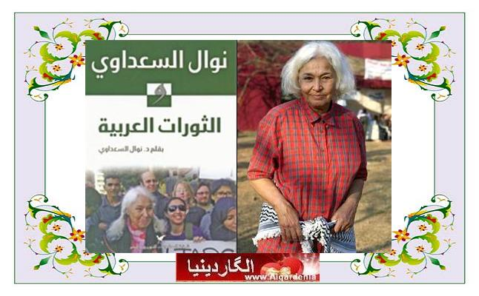
Nawal and her book about the Arab revolutions

Slide 14
6. Nawal – columnist of major newspapers
When we met in Cairo in December 2010 Nawal considered stopping writing her columns because the editors of al Masry al Youm interfered with her texts. I advised her to go on writing.
I am happy she decided to go on. Today, in 2020, she is still going strong, with regular columns in the major newspapers, al-Masry al-Youm and al-Ahram.

Slide 15
The latest columns by Nawal: Al Ahram 23/9 2020 on male polygamy, al Masry al Youm 2/11 on sex and poverty2020

Slide 16
7. The secular activist – more important than Mahfouz and Zuweil?
When Nawal was the victim of disgraceful insults in a TV-show, the editors of Al-Ahram at first refused her column. But the editors recovered and published a long criticism of ”the many enemies of Nawal el-Sadawi”.
The author of the article, Hazim Rifaat, claimed that ”Egypt ought to be proud of Nawal el-Saadawi” and suggested that she might be an even greater personality than the two Egyptian winners of Nobel Prizes, Naguib Mahfouz (literature 1988) and Ahmed Zuweil (chemistry 1999), because “she has helped hundreds of thousands of girls to improve their lives”, not least by her long struggle against khitan of girls.

Slide 17

Naguib Mahfouz – Nawal’s equal?

Slide 18
8. Her mothers regret
In a column in al-Ahram in the summer of 2020 Nawal movingly recalls how her mother at her deathbed asked Nawal to forgive her for having allowed this crime, khitan, against her daughter.
Nawal comments: “How can this type of violence against the natural human body be supported by people who claim that their God has created humans into perfect copies of himself?”

Slide 19
Circumcision does not come from religion

Slide 20
9. Woman at point zero
One of the first novels by Nawal is also one of the most fiercely feminist, about an imprisoned prostitute, Firdaus, who is awaiting execution for murder.
Firdaus accepts to see Nawal and tells her the sad story of her life, from the poverty in the village, studies in Cairo, marriage with a violent maltreater, flight into luxury prostitution.
Firdaus says: "All the men I did get to know, every single man of them, has filled me with but one desire: to lift my hand and bring it smashing down on his face. But because I am a woman I have never had the courage to lift my hand."
Finally she mobilises her powers and kills a man who demands to become her pimp.
When Nawal travels back to her apartment she thinks: ”Firdaus has been braver than I have been”.

Slide 21


Slide 22
10. Ridiculing religious men
Nawal’s novels and short stories and plays often ridicule religious men. One example is Mawt al-Rajul al-Wahid ala al-Ard (1974), which means The Death of the Only Man in the World.
Another example is The Fall of the Imam, which tells the story of Bint Allah (daughter of God), a beautiful illegitimate girl, whose father is the Imam.
Nawal sometimes has an approach similar to that of the Danish author Hans Christian Andersen, with his famous tale about “the Emperor’s new clothes” – clothes that don’t exist and in fact leaves the poor guy naked, a fact that however is denied by everybody until a child shouts the obvious truth: “But he wears nothing at all!”
Nawal is the truth-revealing “child”, seeing what others refuse to see although they actually see it. She dismantles the hypocrisy and stupidity of the patriarchal, religious men in power .

Slide 23
11.God resigns at the Summit Meeting
Nawal’s play God Resigns at the Summit Meeting (1996) created uproar in the Islamic hierarchy. Al-Azhar leveled apostasy charges.
The main characters of the play are Abraham, Moses, Jesus, Mohammed, Radwan (keeper of the gates of paradise), Isis, Eve, Virgin Mary, Bint Allah (20 years old), Satan, and God/Allah.
The prophets are questioning the decisions by God - on Palestine, on mass killings etc.
The women are even more critical: Why should Abraham kill his son, why should men have their foreskin cut off, etc?
The Most High God is losing his beliefs and says that it is time for the world “to continue progressing without a God and without a Satan also”, because this has created separation between body and spirit and between men and women.
So first Satan resigns and then God.

Slide 24

God resigns at the Summit meeting

Slide 25
12 Twelve women in a cell
In the play Twelve women in a cell, twelve women, representing all ages, professions, religions, geographical areas etc. of Egypt, have been put into a common cell for unclear political reasons.
Nawal manages to describe the very complicated, multi-cultural and contradictory composition of a country which many Westerners look upon as a unidimensional Moslem state.

Slide 26
13.Nawal and the Tamarrud regime change June 2013
Some days after the dramatic ousting of president Mursi and the regime of the Muslim Brotherhood, on June 30, 2013, Nawal wrote:
“Thirty-four million youth, men, and women went out into the streets and squares. …They wanted to expel all who would use religion for economic and political gain and to oust Morsi”.
To Nawal Islamism has always been the greater evil, an opinion which made her side with Tamarrud (Revolt) against the Islamist regime and support the military intervention to topple Mursi in the summer of 2013.

Slide 27
14. Most Egyptian intellectuals opposed the Moslem Brotherhood.
After the regime change I was approached by my old Egyptian friends Iqbal Baraka, chair of Egyptian PEN and author of pamphlets against veils, with demands to sign a petition supporting general al-Sisi.
Alaa al-Aswany, author of the globally famous The house of Yacoubian maintained that the massacre of Islamists was unavoidable and stated that Egypt was heading for democracy.
The president of the Egyptian authors union, Mohammed Salmawy, accused the West of being more concerned about “terrorists” than about the Copts.
Hoda Abdel Nasser, the eldest daughter of president Gamal Abdel Nasser, supported general al-Sisi, comparing him with Charles de Gaulle.
When Nawal was forced to choose between two evils – religious or military authoritarianism – she, like most of the secular Egypt, preferred to risk a military regime, which after all, she was used to since 1952.

Slide 28

Alaa al Aswany

Slide 29
15 Memories of a 85 year old girl
One of her latest books, a collection of columns and articles, which is not translated but in English would be Memories of a 85 years old girl, is a proof of Nawal’s continued militancy. About veils she is tough: “The niqab is a kind of terror and murder of the personality of a woman, and of her humanity and honor”.

Slide 30
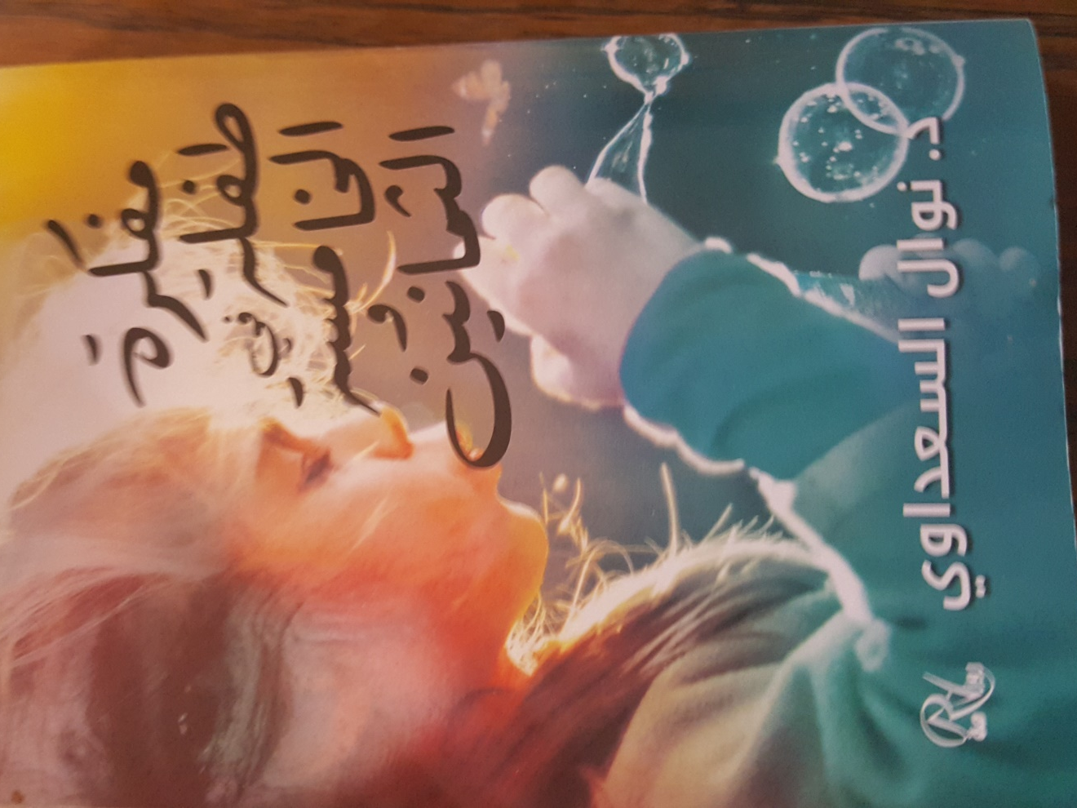
Mudhakirat tifla fi-l khamisa wa thamanin, 2017 (Memoirs of a 85 year old girl) , Èditions Roznameh, 2017, Cairo

Slide 31
16 Seven accusations of heresy.
In this book Nawal lists seven cases when she was accused of heresy:
1. When she wrote that kissing of the black stone at the Kaaba was a tradition even before Islam. She was accused of heresy, but was acquitted.
2. When she said that God has no body, thus cannot have a sex (and cannot be “he”).
3. When she observed that khitan has no relation to islam.
4. When she protested against the acceptance of four wives for men.
5. When she criticized the racist patriarchal system
6. When her enemies demanded forced divorce and withdrawal of her Egyptian citizenship. But she was acquitted in 2008.
7. When her daughter Mona wrote that children should have not only the name of the fathers but also of their mothers; they were acquitted and a new law gives the right to children with an unknown father to wear the name of the mother.

Slide 32
17. A Daughter of Isis
It is no coincidence that Nawal as title for the first part of her autobiography chose the title A Daughter of Isis.
She suggests that originally women had the power because mothership was known, paternity not.
She claims: “The philosophy of Nuut and Isis and Maat was more progressive than that of Plato and Aristotle, because the Egyptian goddesses did not separate the body from the brain and the soul and the society”.
“What has happened since the time of Isis with humanity, to make a female head something shameful that must be concealed under a veil?”

Slide 33
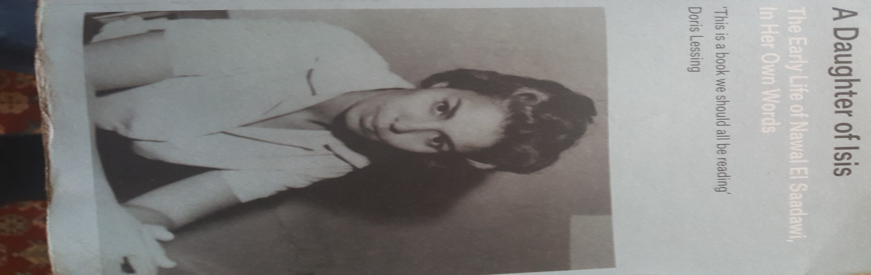

Slide 34
18. Swedish major newspaper: Nobel prize to Nawal
In a review article on one of Nawal’s latest novels, Innahu al-Dam, a major Swedish daily in April 2014 wrote: “With The Revolution Writers Nawal el-Saadawi has given us one of the great feminist novels… this overview of the Egyptian revolution had to be written by a woman - a steady candidate for the Nobel Prize. Now it is really time for that!”
The importance of Nawal el-Saadawi for the struggle for women’s rights, against patriarchy, especially in the Arab world, has been immense.
This struggle has mainly been pursued by literary works of a quality that would justify the Literary Nobel Prize.
But the work of Nawal undoubtedly could also qualify her for the Nobel Peace Prize, which has often been given to activists who have fought not only for peace, but also for justice.

Slide 35

Revolutionsskrivarna=The Revolution writers= Innahu al damm

