Slide 1
NOVEMBER 2020
Impossible Forms
Hadeel Eltayeb, Associate Curator
Northwestern University in Qatar
‘International Conference on Celebrating Arab Women—Agents of Change and Progress ’

Slide 2
NOVEMBER 2020
Alia: The only past I know is here. Everything else is just fairytales.
Dunia: Entire nations are built on fairytales. Facts alone are too sterile for cohesive understanding. Soon what we have achieved here will be a myth of its own.
From ‘In Vitro’ (2019). Work by Larissa Sansour

Slide 3
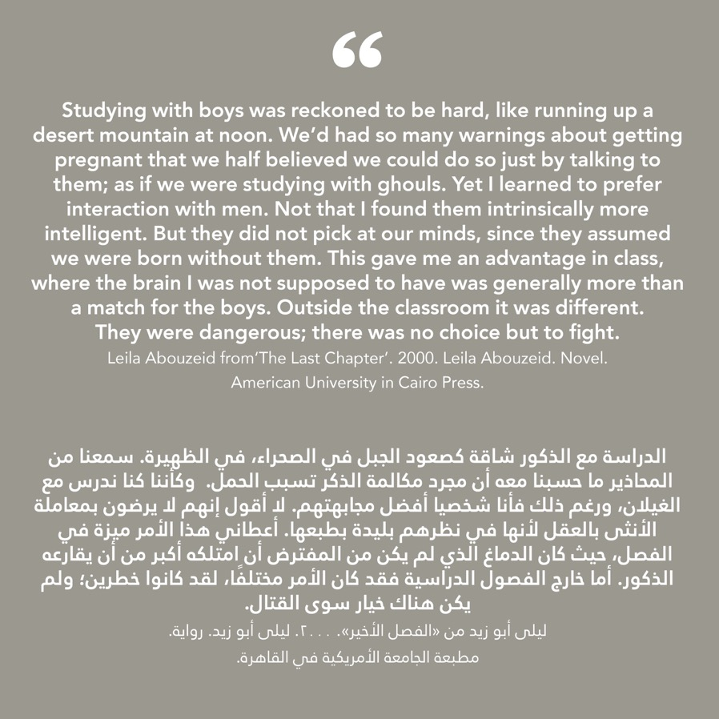
INTRODUCTION

Slide 4
VENICE BIENNALE 2019

Slide 6
LARISSA SANSOUR &
SØREN LIND

Slide 7
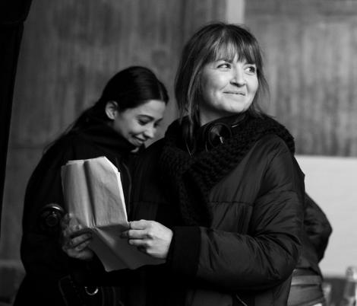
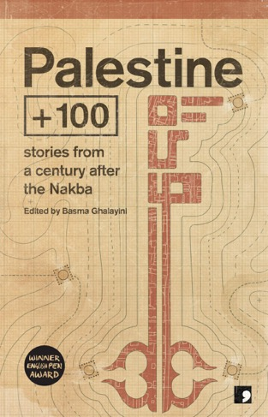
TESTIMONY
TEMPORALITY
Leila Abdelrazaq
Basma Ghalyani

Slide 8
THE FUTURE
I knew of you, Professor Kamal, since I was a young (sic). The faces of you and your family were graffitied on the wall in our camp. Mona Kamal; a legend. We all worshipped you, particularly the women, I knew of your construction of the first generation of Body-Bots in the underground bunker in Rafah; your ingenious use of 3D printers to create robotic limbs for the disabled, creating our own army if indestructible fighters.” (Dabbagh 2019, p.23)
“Neurotic?’ What does that mean in this disassociated world? We all had our synapses shot to smithereens with everything around us” (Dabbagh 2019, p.40)
“

Slide 9
REPETITION
“The importance of testimony may not lie in its adherence to fact, but its departure from it. Imagination, symbolism and desire emerge.”
(Portelli 1991a)

Slide 10
REPETITION
“The General Assembly weren’t just nosey about you two. They’re nosey about everyone. Being paranoid in The Enclave is nothing more than being streetwise: in my first interview for the role they went straight into asking me about my personal life, my family’s history and my sexual relations.” (Debbagh 2019, p.30)

Slide 11
A, Contact.
- Narrator-oriented: expanding the performance
Narratee-oriented: testing the reception
B, Memory.
- Narrator-oriented: filling gaps, correcting mistakes.
Narratee-oriented: securing perception and retention
(Portelli 1991b)

Slide 12
“Orality is impermanent, and therefore its values are memory, tradition, conservation, and repetition, while its practice is determined by the difficulty of conserving, remembering and duplicating anything exactly. Writing is stable and permanent, and therefore its values are innovation, change, and experimentation, while its practice consists of prints, libraries, archives and makes it difficult for typographic culture to ever forget or throw away anything.” (Portelli 1991b)

Slide 14
TEMPORALITY
““I’m going to send on as a voice file to both of you. It is a vocal, digital letter of apology. No, it is more than that. It is a vocal, digital letter of apology with evidence. That is what I do after all, I record things. Like you two, for example.” (Dabbagh 2019, p.1)

Slide 15
TEMPORALITY
“I can tell you what Dr. Kamal said after that, but you may prefer to listen.
KAMAL: She’s a recorder. Look at her equipment. Who gave you this?
I’d rather you did not think of me being a creep, or a snoop. I am not even a proper spy. Okay, yes I was a recorder, but I did not know what that meant when I was recruited. I am sorry for the shock I caused you. I can hear it in both your voices. Listen…” (Dabbagh 2019, p.22)

Slide 16
TEMPORALITY
“END OF RECORDING
You can hear that I am becoming more strident in my condemnation of you, Dr. Schott. At the time I was actually becoming less and less sure of what I was doing and I believed in, but I was unable to back out. My interview process involved a stage I need to explain.” (Dabbagh 2019, p.36)
“It was a high-definition reproduction of a piece of my past I’d managed to erode from my mind. It became so vivid, I could smell the boy after that, his breath like oil from cigarettes. I couldn’t talk after that. It didn’t matter the official did the talking for me.” (Dabbagh 2019, p.38)

Slide 17
TEMPORALITY
“Dual temporality: the ways the political and perhaps epistemological status of time are tethered to both the original incident and the act of memory itself” (Stein 2015)

Slide 19
LEILA ABDELRAZAQ
BADDAWI

Slide 20
LEILA ABDELRAZAQ
BADAWWI

Slide 21
REFERENCES
Abdelrazaq, L (2015) Baddawi. Charlottesville: Just World Books
Dabbagh, S (2019) ‘Sleep it Off, Dr. Scott’ in Ghalayani, B (ed), Palestine + 100. London: Comma Press, pp.21-42
Derrida, J (1993) Archive Fever: A Freudian Impression. Chicago: University of Chicago Press
Enwezor, O (2007) Archive Fever: Uses of the Document in Contemporary Art. New York: Göttingen: International Center of Photography and Steidl, p.13
The Media Majlis (May 21, 2018) ‘Leila Abdelrazaq’, Available at: mediamajlis.northwestern.edu (Accessed: Nov 5 2020)
Portelli, A (1991a) ‘What Makes Oral History Different’ in Portelli, A (ed), The Death of Luigi Trastelli and Other Stories. Albany: State University of New York Press, pp.45-58
Portelli, A (1991b) ‘Absalom, Absalom!’ in Portelli, A (ed), The Death of Luigi Trastelli and Other Stories. Albany: State University of New York Press, pp.271-282
In Vitro (2019) Directed by Larissa Sansour and Soren lind [Film]. Bristol: Spike Island
In The Future They Ate The Finest Porcelain (2016) Directed by Larissa Sansour and Soren lind [Film]. Bristol: Spike Island
Nation Estate (2013) Directed by Larissa Sansour and Soren lind [Film]. Bristol: Spike Island
Stein, R (2015) ‘Dispossession Reconsidered: Israel, Nakba, Things’, Ethnologie française, 45 (2). Available at: www.cairn-int.info/journal-ethnologie-francaise-2015-2-page-309.htm?WT.tsrc=cairnPdf (Accessed: November 5 2020)

