Slide 1
A “deviant” choice Emirati women married to non- Emirati locals: a legal and anthropological perspective
Dr. Leslie Vandeputte, Ms. Karoleen Molaeb, Ms. Casiana Pascariu
American University in the Emirates – Dubai

Slide 2
Outline
Introduction
Research questions
Research methods
Analyzing the data
Marriage in the UAE
Women's rights in the UAE
Emirati Women and UAE nation
Conclusion/ Recommendations
Notes:
Since the formation of UAE (1971), the government encourages a fortified consolidated Emirati family where Emirati men marry Emirati women. In order to maintain this Emirati social demographic composition, a federal law No. 47 was adopted in 1992 establishing the Marriage fund which provides financial assistance to Emirati men who are about to get married to Emirati women.1 Conserving a cohesive stable traditional family is among the core values of UAE. In 2016, however, the Marriage fund was dissolved, and all its realms were integrated within the Ministry of Community Development (MoCD). MoCD pursued with UAE’s vision of an orthodox family. The Ministry initiated the “Marriage Grant” service as a financial subsidy to Emirati men who are espousing to “contribute to the establishment of a stable and firm Emirati family; within the conditions and regulations of the grant which contributes to encouraging marrying Emirati women”.2 The first condition to benefit from this service is that both partners ought to be UAE citizens. These policies were enacted to encourage Emiratis marry their compatriots since in the past decade there was a surge in “mixed marriages” .3 The following section examines the present trend of “Emirati women who married non-Emirati citizens in UAE” from a legal constitutional perspective as well as from an anthropological one. It aims at understanding the rights of those women and their offspring in terms of legacy, citizenship, property transmission, etc. Also, this article focuses on cultural and national identity and analyzes these women’s attachment to the nation despite their “deviant choice”.

Slide 3
Research questions
Two aspects :
What are the rights of Emirati women who married non-Emirati citizens in terms of legacy, citizenship, property transmission, etc.?
What relationships Emirati women who married non-Emirati citizens have with their family and more broadly with the society, the culture and their country?

Slide 4
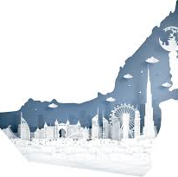
Research methods
6 in-depth interviews with Emirati women (between 21 and 60 years old)
2 in-depth interviews with Emirati males (between 22 and 38 years old)
3 interviews with lawyers/ experts
Notes:
Fatima 1 + abdullah son
Shamsa
Ayat
Fatima 2+ abdullah
Eptisam
Fatima 3

Slide 5
All of our meetings and interviews looked like this...

Slide 6
Analyzing the data
Marriage in the UAE
Women's rights in the UAE
Emirati Women and UAE nation

Slide 7
Constitution and Law : defining marriage
Under Article 7 of the constitution, UAE adopts Islam as its official religion where Islamic Sharia is the main derivation of law.
Marriage and family institutions follow the Islamic principles and laws stated under the Quran.
The Quran does not specify that a woman should marry a Muslim man, nevertheless, all schools of Islam concur that the contract is nullified if the man is non-Muslim.

Slide 8
“My husband was totally fine to live in Dubai. In London, it will be different. I am used to live in Dubai so it will be difficult for me to move. We totally agreed to raise our family in UAE. Our children will get citizenship and they will be Emiratis.”
Aminah, 21

Slide 9
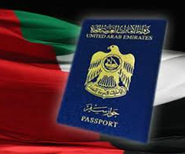
Women's rights in the UAE
Citizenship
Property transmission
Offsprings
Socio Marital Changes

Slide 10
Citizenship
Updated laws
The woman still needs the approval of a male quardian, compared to an Emirati men
Very long time to receive the citizenship for their offsprings and spouses 15-30 years
Notes:
Updated laws that makes the lives of emirati women married to non-emirati easier.

Slide 11
Property transmission
Sharia law makes the property transmission easier and clear
Western views: independent finacially from the family
Financial exclusion from imediate and extended family
This Photo by Unknown author is licensed under CC BY-NC-ND.

Slide 12
Offsprings
Dress code
Religion
Rights and benefits of citizenship for offspring of Emirati woman married to a non-Emirati man
Legacy: pluralism and multiculturalism
This Photo by Unknown author is licensed under CC BY.

Slide 13
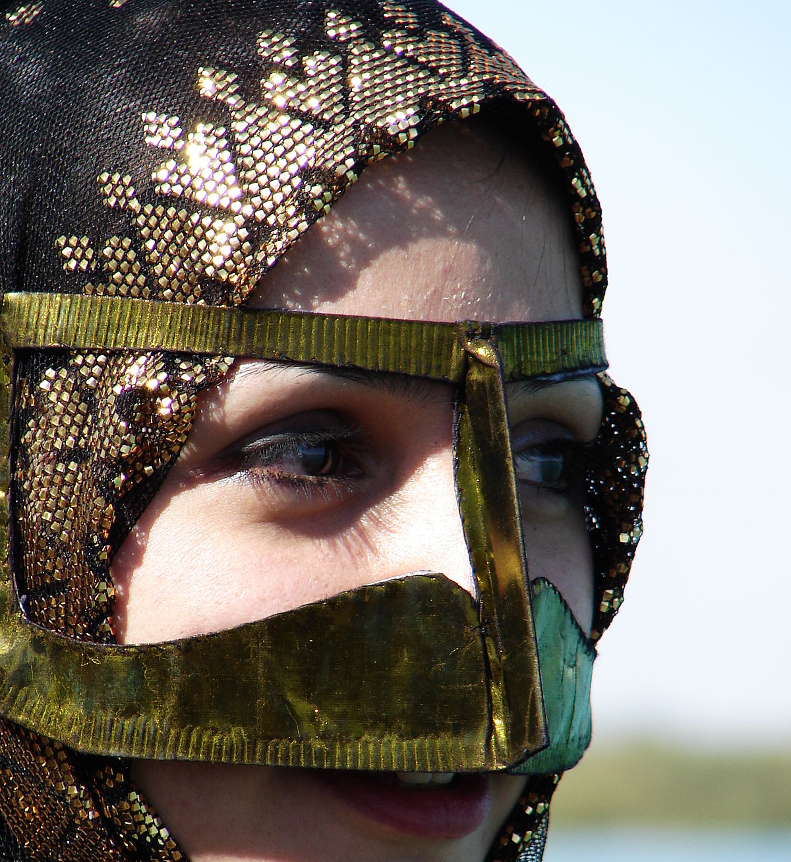
Socio Marital Changes
Force dress code: abaya and shayla
No honor killing but still being disowned
Social bullying: from school to family members
This Photo by Unknown author is licensed under CC BY-SA.

Slide 14
Emirati Women and UAE nation
UAE : a vision of a cohesive demographic structure
Promoting a sense of unity
Homogeneity vs. Heterogeneity
National and cultural identities
From a strong attachment to rejection

Slide 15
"My late husband was from Bahrain. My first condition was to live in Dubai. I love my country." Farah, 60 years old.
"Look ! she is not even local and she is wearing abaya" Enam 35 years old, quoting remarks she frequently heard
""You do not look Emirati" , my accent, my body shape is always associated with Egyptian." Amirah, 34 years old.

Slide 16
Results/ Conclusions
The laws are perspicuous and UAE women whether marrying a local or non-local have equal rights to start a family.
Women did not have any conflict with the Article 47 about marriage.
The Offspring of mixed marriages got their UAE passport - sometimes it took a long time
The national dressing Abaya is considered as a strong marker of cultural and national identity.
Speaking the Arabic-Emirati dialect is considered essential in being Emirati.
Culturally, marrying a person from a different country is still perceived as "deviant", abnormal.
Having the same religion helps the family to accept the woman's decision to marry a non-national.

Slide 17
"My husband was more than happy to convert to Islam. Indeed, he was a Christian coming from the British descendant, but he was born in UAE. He was raised in UAE, and he wanted himself to convert to Islam. I would have not married him."
Aminah

Slide 18
Recommendations
Easier way for the offspring (Emirati women married to non-Emirati) to receive citizenship.
Raise awareness on anti-bullying and tolerance towards family members (especially women) who marry outside of the culture.

Slide 19
References
Akinci, Idil. (2019) Dressing the nation? Symbolizing Emirati national identity and boundaries through national dress, Ethnic and Racial Studies, DOI: 10.1080/01419870.2019.1665697
Khattab, A. M. (1997). Muslim Family: Idealism and Realism. In G. L. Anderson (Ed.). The Family in Global Transition, (pp. 253Ͳ279). Minnesota: A Professors World Peace Academy.
Al Hourani, M (2019). Lived experiences of young Emirati women in the combined family: Extending and rethinking sociological concepts in International Journal of Sociology and Anthropology, vol. 11 (3), pp. 27-36.
Al Oraimi S (2013). The Concept of Gender in Emirati Culture: An Analytical Study of the Role of the State in Redefining Gender and Social Roles https://onlinelibrary.wiley.com/doi/abs/10.1111/muse.12009
Kemp, Linzi J (2013). Progress in female education and employment in the United Arab Emirates towards Millennium Development Goal (3) – gender equality,” Foresight: The Journal of Future Studies, Strategic Thinking and Policy, 15(4), pp. 264-277.
The United Arab Emirates' Government portal ( 2020). Marriage : Marriage under the UAE's law
https://u.ae/en/information-and-services/social-affairs/marriage

Slide 20
Thanks for your attention
شكرا على انتباهكم

