Slide 1
Preserving Her Story
Legendary Women of Ancient Mesopotamia
By: Weam Namou

Slide 2
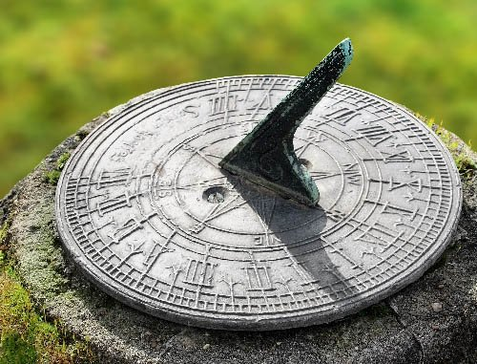
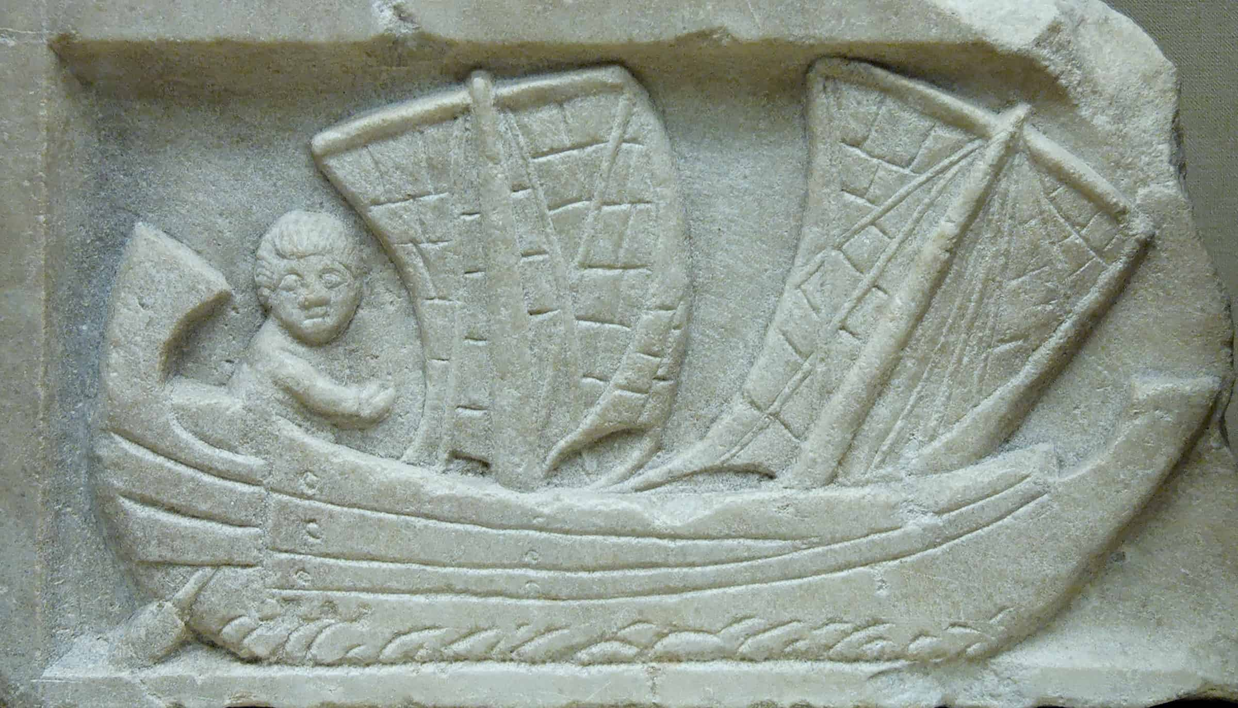
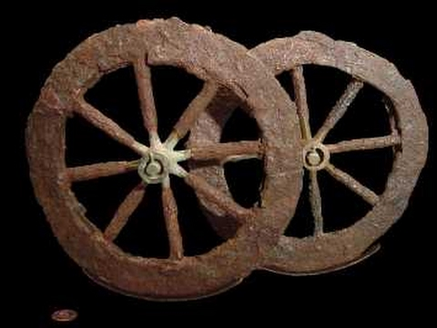
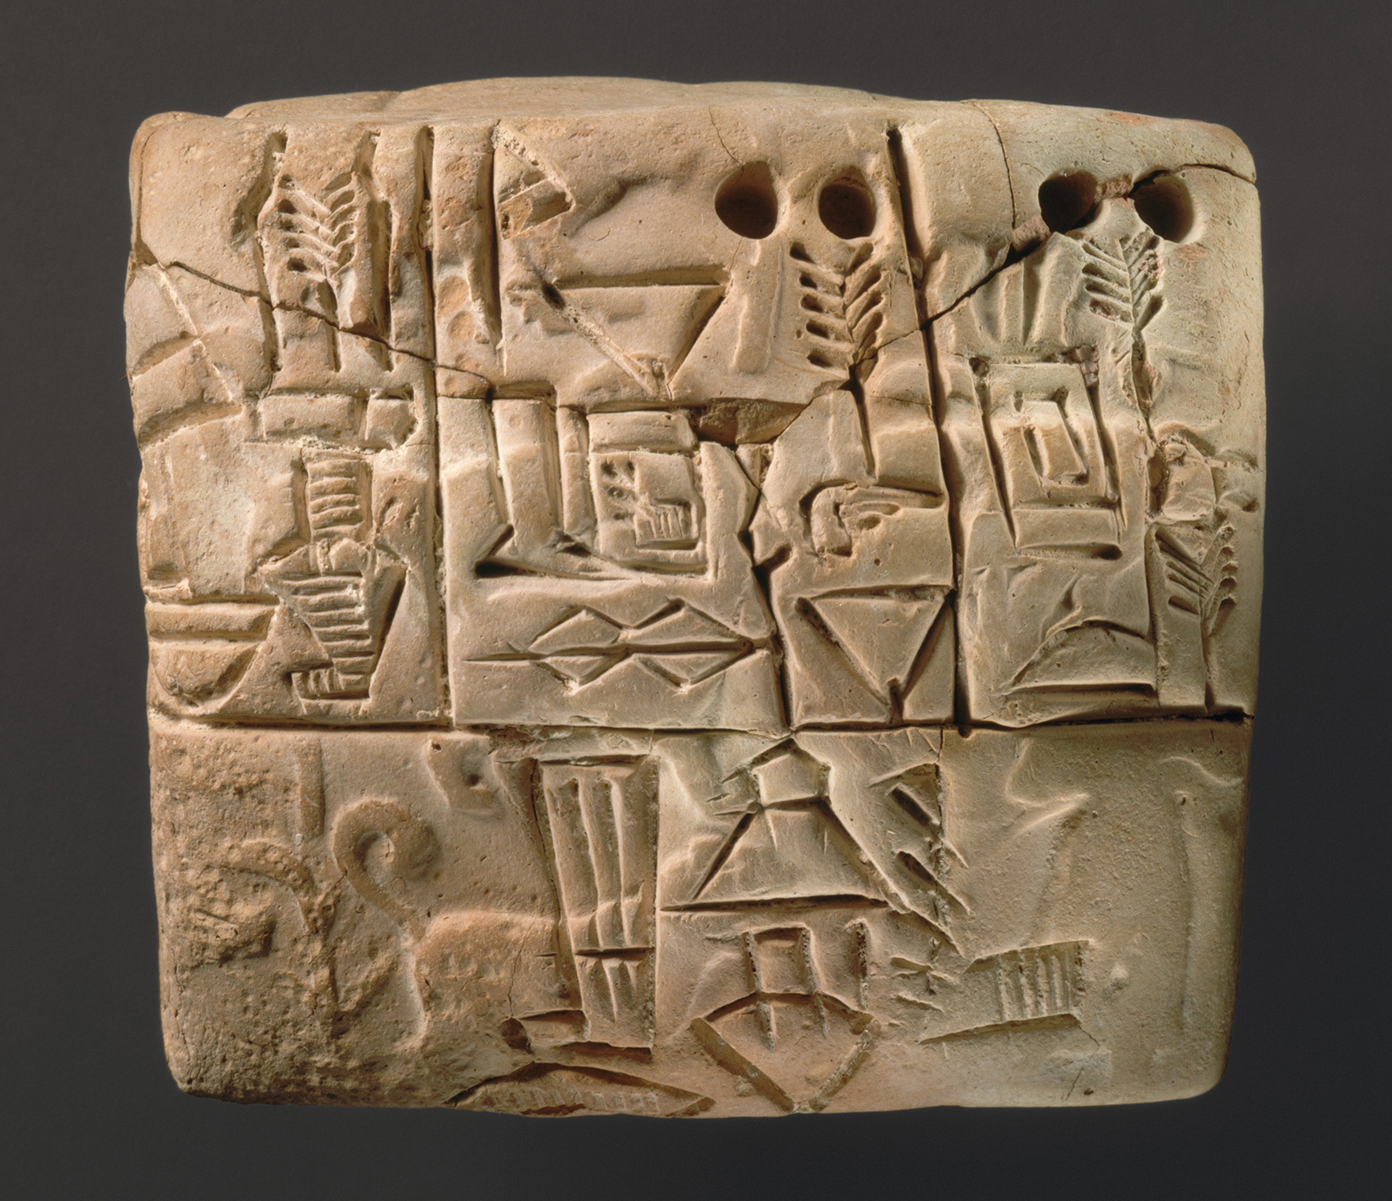
Significant Achievements of Mesopotamians
Writing - the Wheel - Agriculture - Mathematics
Astronomy - Laws - Contracts - Time

Slide 3
But what role did women play in building this great empire?
As I researched and discovered the answers to this question, I began writing my13th book, Mesopotamian Goddesses: Unveiling Your Feminine Process, a process which also had me learn a great deal about my ancient Chaldean (Neo-Babylonian) roots.

Slide 4
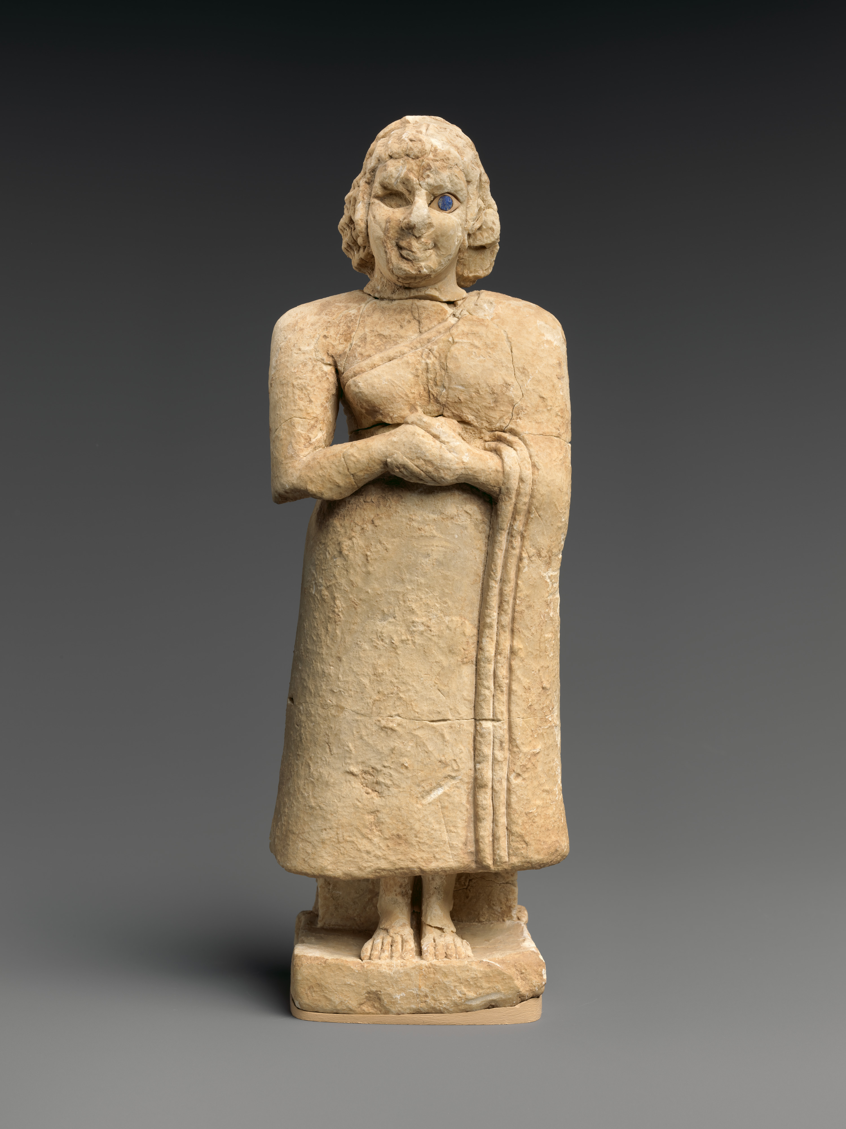
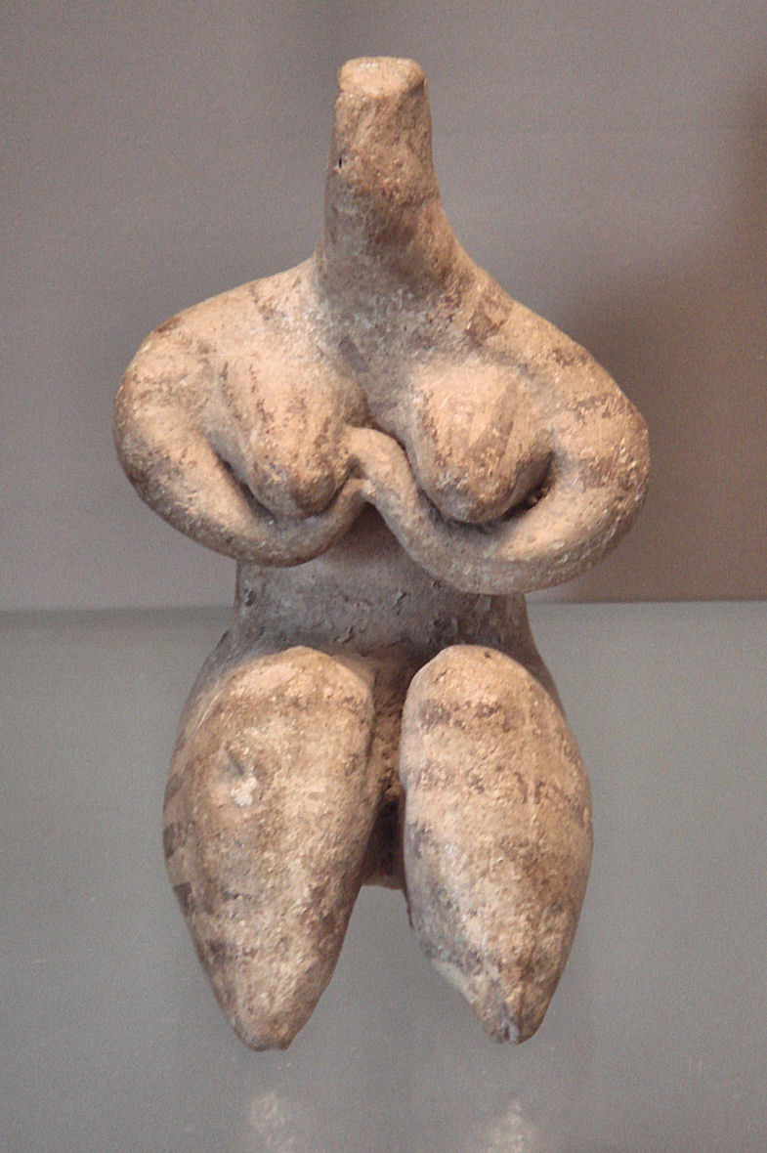
The Hidden History
Fertility figurine of the Halaf culture, Mesopotamia
6000-5100 BCE
About a 100 years ago, the existence of the goddess began to emerge when archeologists found magnificent discoveries that revolutionized peoples’ understanding of women’s roles in that region.
Standing Female Worshipper
2600 – 2500 BC – Found in
Nippur temple of Inanna, the Sumerian goddess of abundance

Slide 5
Enheduanna (2285-2250 BCE)
Princess, Priestess and the World’s First Recorded Writer
In 1927, British archaeologist Sir Leonard Woolley discovered the Enheduanna calcite disc during excavations of the Sumerian city of Ur.
She’s the first recorded writer, having signed her name at the end of her hymns.
She wrote and taught about 3 centuries before the earliest Sanskrit texts, 2000 years before Aristotle, and 1,700 before Confucius.

Slide 6
The back of the disk bears an inscription, a dedication from Enheduanna to the moon god. This is what makes the object so important. We can identify the person who dedicated it and her position as high priestess. We can also match her name with other occurrences. Enheduanna lived at a time of rising patriarchy. It has been written that, as secular males acquired power, religious beliefs had evolved from what was probably a central female deity in Neolithic times to a central male deity by the Bronze Age.

Slide 7
Queen Kubaba The Only Woman Among the List of Sumerian Kings
She was a successful businesswoman as a tavern keeper, and she was also successful as a queen. 2500 – 2330 BC
Kubaba’s kindness caused the god Marduk to give her royal dominion of all lands.
After her reign ended, story has it that she went back to being the alewife, feeding local fishermen who lived near her house.
Kuaba was later worshipped as a goddess.

Slide 8
Early Phoenician seal, dedicated to goddess Kubaba by Matrunna, daughter of Aplahanda, 19th century BCE
In later generations, Mesopotamians decided it was unnatural for women to uphold traditional roles for men and provided this omen to make sure no other woman dares to improperly cross that line again:
If an androgyny is born, with both rod and vagina – omen of Kubaba, who ruled the country. The country of the king shall be ruined.

Slide 9
Gula The Great Healer
Initially, Gula was a Sumerian deity known as Bau, goddess of dogs. Gula’s cylinder seals portray her always with a dog, sometimes seated, and surrounded by stars.
Gula’s son, Ninazu, carried a rod entwined with serpents. This symbol was adopted by the Egyptians, later the Greeks, and today, one sees the caduceus in doctor’s offices and medical practices around the world as the sign of Hippocrates, the father of medicine.
A cult center for Gula, the city of Isin is thought to have served as a training center for physicians, who were assigned to temples in different cities as needed.
Medical books from the library of Ashurbanipal indicate that doctors had remarkable amount of medical knowledge and applied this repeatedly in caring for their patients and appeasing the gods and the spirits of the dead. People accredited this knowledge to Gula as a gift from the gods.

Slide 10
The status of female deities began to diminish during the reign of Hammurabi (1792-1750 BCE) and afterward, when male gods dominated the religious arena. That wasn’t the case with Gula, however, whose worship remained with the same respect.
Adoration of Gula continued well into the Christian period, and in the Near East, Gula was as prevalent as many well-known deities. Her cult declined little by little, and by the end of the first millennium CE, she had been forgotten.

Slide 11
Maria Theresa Asmar
Maria Theresa Asmar (1804 – before 1870) was a Chaldean Catholic from the village of Tel Keppe. Facing tremendous obstacles, Asmar, a set up a school for women in Baghdad, and welcomed with open arms western Christian missionaries, who then bribed the Turkish government to give them a license for the school and forbid Maria to carry on with her project.
Left frustrated and angry to have been treated this way by fellow Christians, she sought sanctuary with the Arab Bedouins. She set about recording their daily lives, everything from the weddings and celebrations to their assaults on other tribes. She explains in great detail Bedouin life.

Slide 12
Memoirs of a Babylonian Princess
In the early 19th century, Maria wrote Memoirs of a Babylonian Princess, which consists of two volumes and 720 pages.
In her book, she describes how her family fell to martyrdom - all except for herself. She eventually took refuge with the Emir Beschir, the governor of Lebanon. She also describes her travels through Turkey, Syria, Lebanon, Palestine, and the harem system used in Turkey. From there she moved on to Europe. After staying 12 years in Europe, she wrote her book.
The book was translated into English in 1844. Maria Theresa Asmar died in France before the Franco-Prussian War, and was known as Babylon's Princess in Europe.

Slide 13
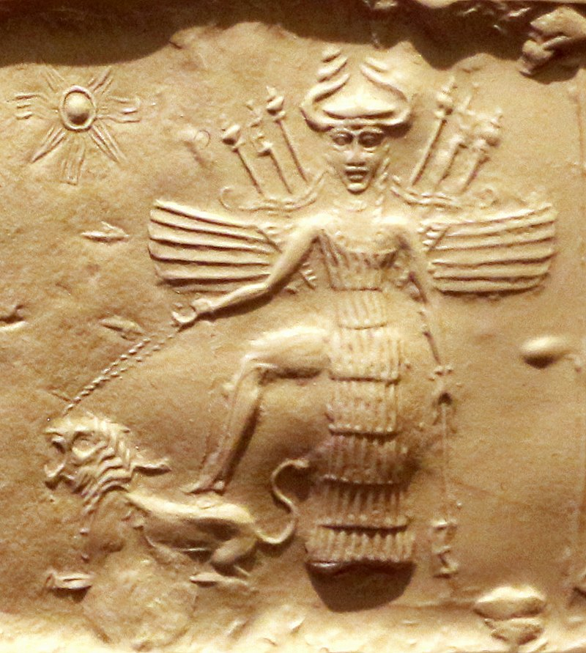
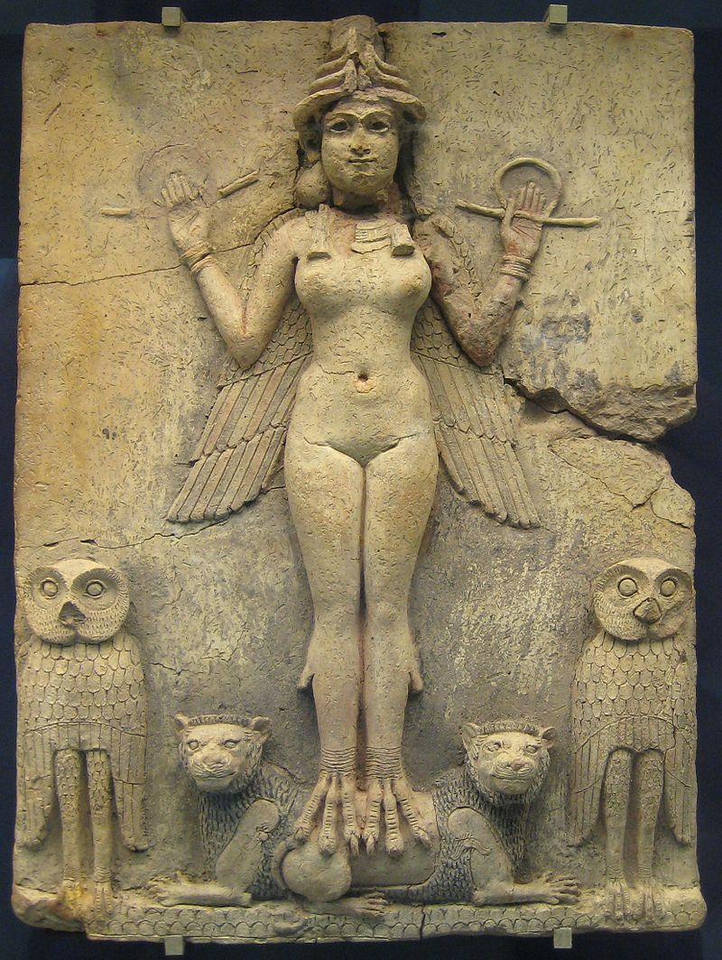
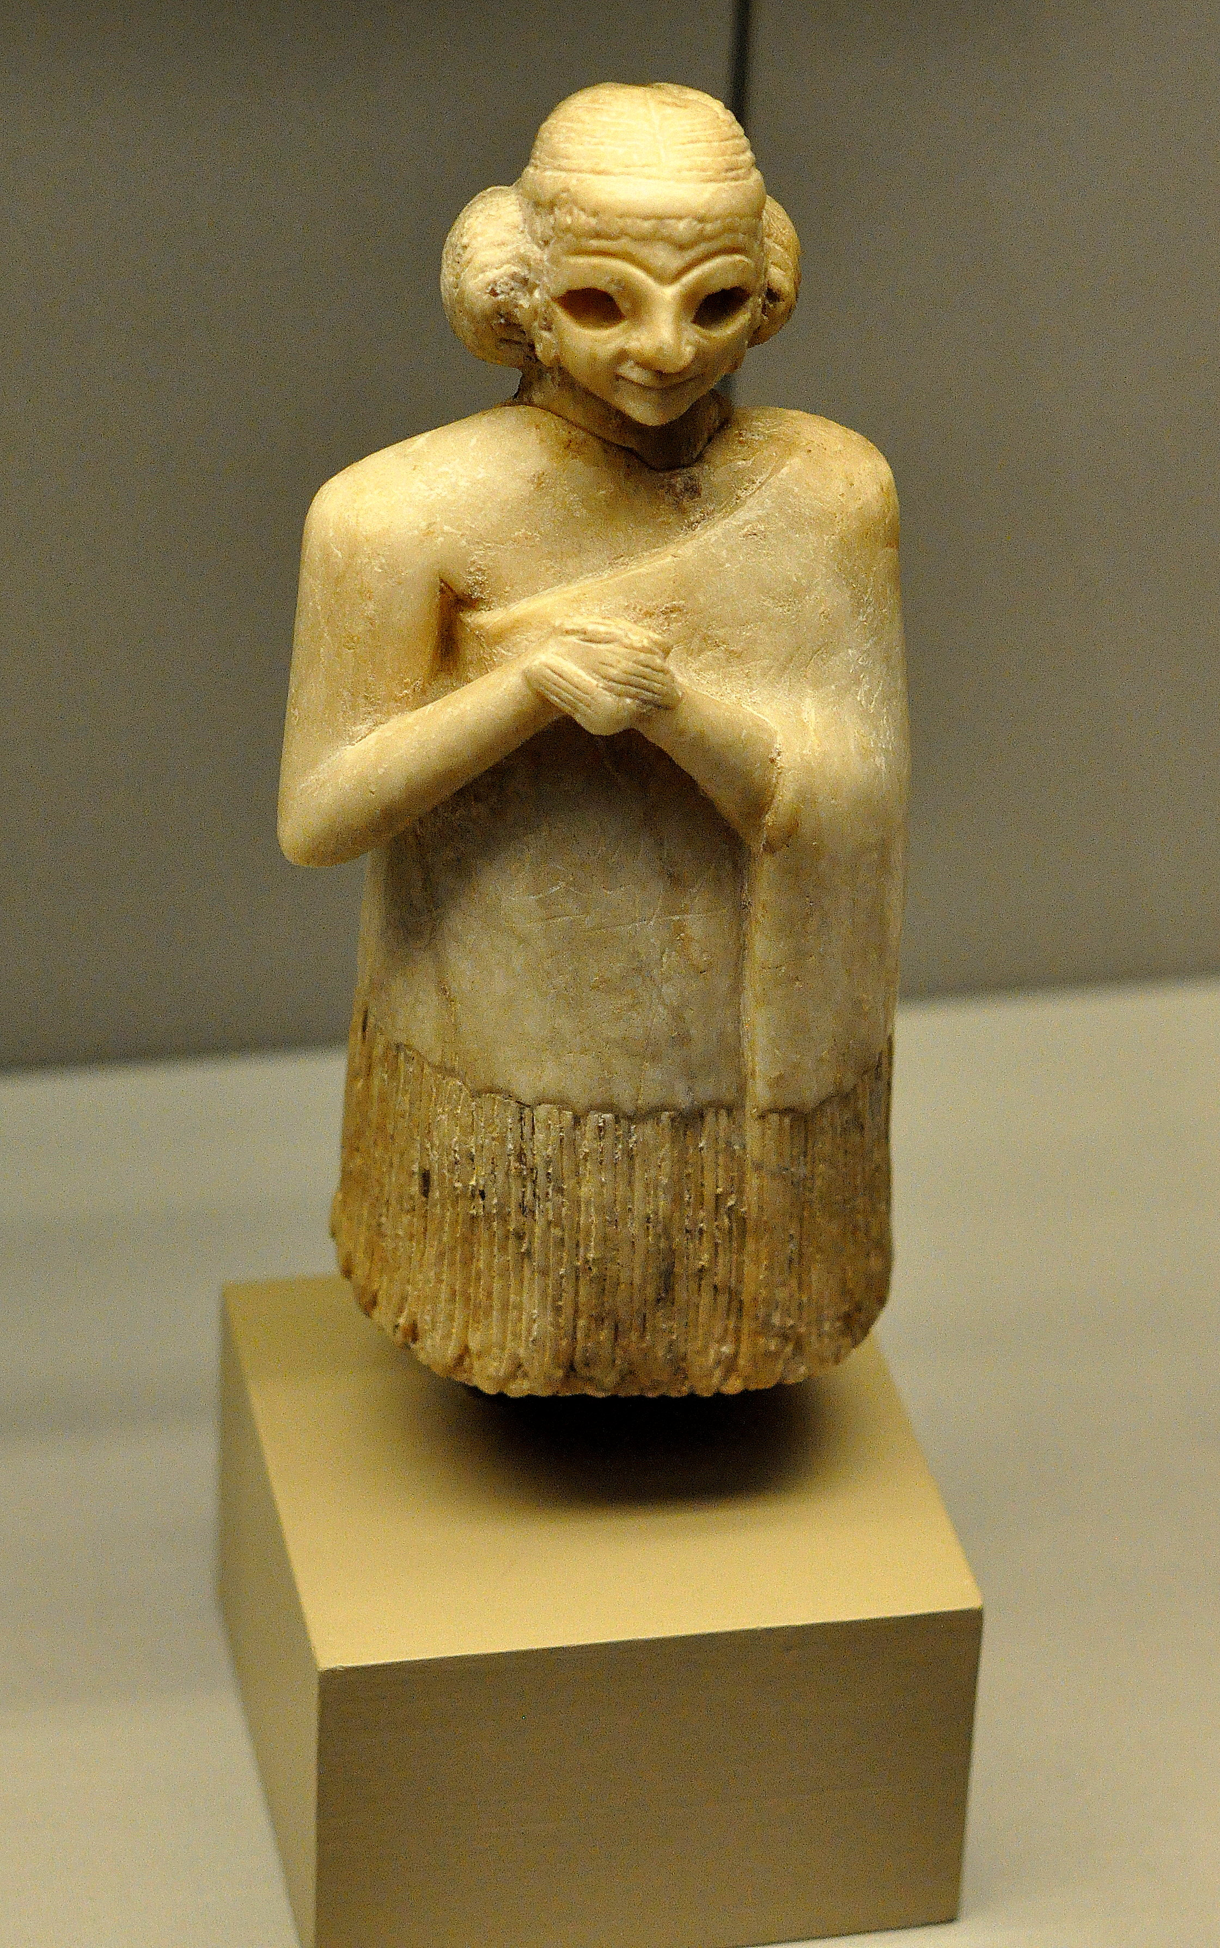
Conclusion
The list of Mesopotamian female deities, queens, and priestesses are long. It’s obvious from the position they had that, early on, women were respected and highly visible.

Slide 14
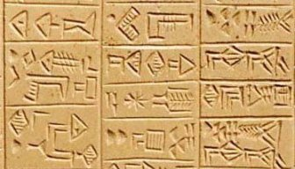
Unfortunately, their participation in the building of the cradle of civilization was omitted from our mythology until their stories resurfaced in the late 19th century through cuneiform fragments.
This omission has had dire consequences on our world, especially for our daughters who rarely get a chance to view a version of themselves that’s relatable and inspirational, rather than stereotyped and pigeonholed.

Slide 15
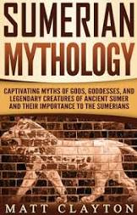
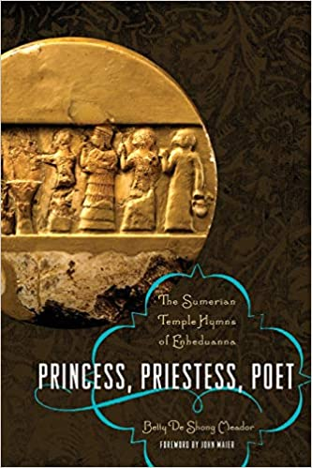
References

